Slide 1

딥러닝 (Deep Learning)
Homework 4
Natural Language Processing using Neural Models (NLU)

Slide 2

Programming assignments
Deep Learning Basic MLP
Object Recognition ResNet
Face Recognition Free choice model
NLU CNN for Sentence Classification
Object Detection YOLO
Image Generation GAN, CGAN, DCGAN
NLG LSTM, Transformer
SSL for Computer Vision ViT
SSL for NLP BERT
LLM ChatGPT

Slide 3
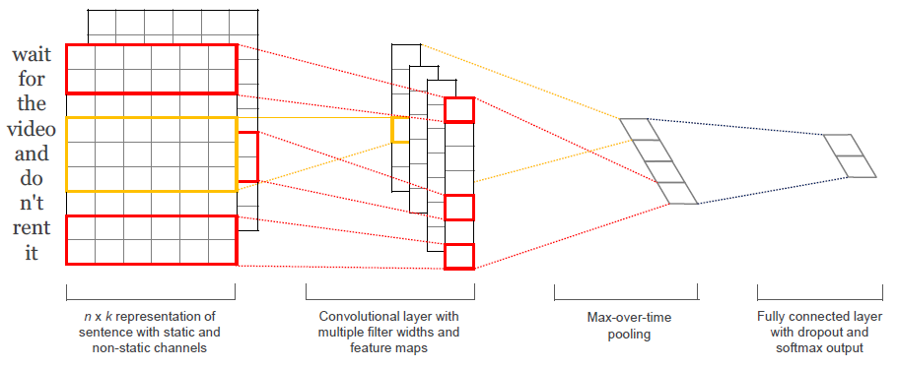
Assignment 4: CNN for sentence classification
Positive Probability
Negative Probability
Word embeddings
[0.3, 0.7]
Negative
Convolution layer
Fully connected layer
Max-pooling layer

Slide 4
Assignment 4: CNN for sentence classification
Word embeddings
Convolution layer
Fully connected layer
Max-pooling layer
[n, k] (k=300)
<Word embeddings>
Used embeddings: word2vec, pre-trained on Google News (Mikolov et al., 2013)
Embedding size = 300

Slide 5
Assignment 4: CNN for sentence classification
Word embeddings
Convolution layer
Variations | Embedding Initialization
CNN-rand | X
CNN-non-static | word2vec
Fully connected layer
Max-pooling layer
CNN-non-static performed much better compared to CNN-rand. (4%p better in average)
Proved initializing embeddings is important.
[n, k] (k=300)

Slide 6
Assignment 4: CNN for sentence classification
Word embeddings
Convolution layer
<Filter Weight>
shape = [h, k]
Fully connected layer
Max-pooling layer
h
k
Convolution through filters can preserve important n-gram features.
[n, k] (k=300)
filter:[h, k]
↓
window:[h, k]
Ci

Slide 7
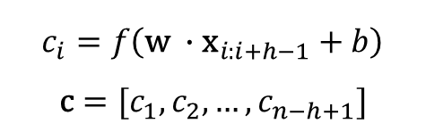
Assignment 4: CNN for sentence classification
Word embeddings
Convolution layer
<Filter Weight>
shape = [h, k, 100] X 3
Fully connected layer
Max-pooling layer
h
X 3
100
k
<Convolution layer>
filter windows(h) : 3, 4, 5
100 filters for each h (total 300 filters)
$$c_{i}=f\left(\text{w} ∙{\text{x}}_{i:i+h−1}+b\right)$$
$$\text{c}=[c_{1},c_{2}, …,c_{n−h+1}]$$

Slide 8

Assignment 4: CNN for sentence classification
Word embeddings
Convolution layer
Fully connected layer
Max-pooling layer
$$\hat{c}=max⁡\{\text{c}\text{\}}$$
<Max-pooling layer>
Max-over-time-pooling (extract max value of each layer)

Slide 9
Assignment 4: CNN for sentence classification
Positive Probability
Negative Probability
Convolution layer
Fully connected layer
[0.3, 0.7]
Negative
Max-pooling layer
<Fully connected layer>
Adapt softmax function
[2, 1]

Slide 10
Assignment 4: CNN for sentence classification
[Objective]
Experiment on two datasets (MR, SNIPS) – datasets are provided.
Classify sentences into each class, respectively.
Use provided basic code (CNN-non-static).

Slide 11
Assignment 4: CNN for sentence classification
[Dataset]
SearchCreativeWork (e.g. Find me the I, Robot television show),
GetWeather (e.g. Is it windy in Boston, MA right now?),
BookRestaurant (e.g. I want to book a highly rated restaurant in Paris tomorrow night),
PlayMusic (e.g. Play the last track from Beyoncé off Spotify),
AddToPlaylist (e.g. Add Diamonds to my roadtrip playlist),
RateBook (e.g. Give 6 stars to Of Mice and Men),
SearchScreeningEvent (e.g. Check the showtimes for Wonder Woman in Paris).
The training set contains of 13,084 utterances, the validation set and the test set contain 700 utterances each, with 100 queries per intent.
Data | Description | Target Class
MR (Pang and Lee, 2005) | Movie reviews | 2
SNIPS (https://paperswithcode.com/dataset/snips) | Classifying a queries into 7 user intents | 7

Slide 12
Assignment 4: CNN for sentence classification
[Model Variations]
Variations | Embedding Initialization | Modified during training | Multichannel
CNN-rand | X | O | X
CNN-static | word2vec | X | X
CNN-non-static | word2vec | O | X
CNN-multichannel | Word2vec | O for one, X for the other | O (two channels)

Slide 13
Assignment 4: CNN for sentence classification
def clean_str(string):
string = re.sub(r"[^A-Za-z0-9(),!?\'\`]", " ", string)
string = re.sub(r"\'s", " \'s", string)
string = re.sub(r"\'ve", " \'ve", string)
string = re.sub(r"n\'t", " n\'t", string)
string = re.sub(r"\'re", " \'re", string)
string = re.sub(r"\'d", " \'d", string)
string = re.sub(r"\'ll", " \'ll", string)
string = re.sub(r",", " , ", string)
string = re.sub(r"!", " ! ", string)
string = re.sub(r"\(", " \( ", string)
string = re.sub(r"\)", " \) ", string)
string = re.sub(r"\?", " \? ", string)
string = re.sub(r"\s{2,}", " ", string)
return string.strip().lower()
def load_mr_data(pos_file, neg_file):
pos_text = list(open(pos_file, "r", encoding='latin-1').readlines())
pos_text = [clean_str(sent) for sent in pos_text]
neg_text = list(open(neg_file, "r", encoding='latin-1').readlines())
neg_text = [clean_str(sent) for sent in neg_text]
positive_labels = [1 for _ in pos_text]
negative_labels = [0 for _ in neg_text]
y = positive_labels + negative_labels
x_final = pos_text + neg_text
return [x_final, y]

Slide 14
Assignment 4: CNN for sentence classification
def buildVocab(sentences, vocab_size):
# Build vocabulary
words = []
for sentence in sentences:
words.extend(sentence.split()) # i, am, a, boy, you, are, a, girl
print("The number of words: ", len(words))
word_counts = collections.Counter(words)
# Mapping from index to word
vocabulary_inv = [x[0] for x in word_counts.most_common(vocab_size)]
# vocabulary_inv = list(sorted(vocabulary_inv))
# Mapping from word to index
vocabulary = {x: i for i, x in enumerate(vocabulary_inv)} # a: 0, i: 1...
return [vocabulary, vocabulary_inv]
def sequence_to_tensor(sequence_list, nb_paddings=(0, 0)):
nb_front_pad, nb_back_pad = nb_paddings
max_length = len(max(sequence_list, key=len)) + nb_front_pad + nb_back_pad
sequence_tensor = torch.LongTensor(len(sequence_list), max_length).zero_() # 0: <pad>
print("\n max length: " + str(max_length))
for i, sequence in enumerate(sequence_list):
sequence_tensor[i, nb_front_pad:len(sequence) + nb_front_pad] = torch.tensor(sequence)
return sequence_tensor

Slide 15
Assignment 4: CNN for sentence classification
def text_to_indices(x_text, word_id_dict, use_unk=False):
text_indices = []
for text in x_text:
words = text.split()
ids = [2] # <s>
for word in words: # i, am, a, boy
if word in word_id_dict:
word_id = word_id_dict[word]
else: # oov
if use_unk:
word_id = 1 # OOV (out-of-vocabulary)
else:
word_id = len(word_id_dict)
word_id_dict[word] = word_id
ids.append(word_id) # 5, 8, 6, 19
ids.append(3) # </s>
text_indices.append(ids)
return text_indices

Slide 16
Assignment 4: CNN for sentence classification
class ConvFeatures(nn.Module):
def __init__(self, word_dimension, filter_lengths, filter_counts, dropout_rate):
super().__init__()
conv = []
for size, num in zip(filter_lengths, filter_counts):
conv2d = nn.Conv2d(1, num, (size, word_dimension))
nn.init.kaiming_normal_(conv2d.weight, mode='fan_out', nonlinearity='relu')
nn.init.zeros_(conv2d.bias)
conv.append(nn.Sequential(
conv2d,
nn.ReLU(inplace=True)
))
self.conv = nn.ModuleList(conv)
self.filter_sizes = filter_lengths
self.dropout = nn.Dropout(dropout_rate)
def forward(self, embedded_words):
features = []
for filter_size, conv in zip(self.filter_sizes, self.conv):
conv_output = conv(embedded_words)
conv_output = conv_output.squeeze(-1).max(dim=-1)[0]
features.append(conv_output)
del conv_output
features = torch.cat(features, dim=1)
dropped_features = self.dropout(features)
return dropped_features

Slide 17
Assignment 4: CNN for sentence classification
# CNN-non-static model
class SentenceCnn(nn.Module):
def __init__(self, nb_classes, word_embedding_numpy, filter_lengths, filter_counts, dropout_rate):
super().__init__() vocab_size = word_embedding_numpy.shape[0]
word_dimension = word_embedding_numpy.shape[1]
# Word embedding layer
self.word_embedding = nn.Embedding(
vocab_size,
word_dimension,
padding_idx=0
) # use word2vec
self.word_embedding.weight.detach().copy_(torch.tensor(word_embedding_numpy.astype(np.float32)))
# Convolutional layer
self.features = ConvFeatures(word_dimension, filter_lengths, filter_counts, dropout_rate)
# Fully-connected layer
nb_total_filters = sum(filter_counts)
self.linear = nn.Linear(nb_total_filters, nb_classes)
nn.init.kaiming_normal_(self.linear.weight, mode='fan_out', nonlinearity='relu')
torch.nn.init.zeros_(self.linear.bias)
def forward(self, input_x):
x = self.word_embedding(input_x)
x = x.unsqueeze(1) # add one channel
x = self.features(x)
logits = self.linear(x)
return logits

Slide 18
Assignment 4: CNN for sentence classification
# 데이터셋
task: MR
data_files:
MR:
pos_file: D:/python/workspace/NLP_lecture/data/MR/rt-polarity.pos
neg_file: D:/python/workspace/NLP_lecture/data/MR/rt-polarity.neg
pos_test_file: D:/python/workspace/NLP_lecture/data/MR/rt-polarity_test.pos
neg_test_file: D:/python/workspace/NLP_lecture/data/MR/rt-polarity_test.neg
oversample_train: true
# 디멘션
model: CNN
model_params_cnn:
filter_lengths: [3, 4, 5]
filter_counts: [100, 100, 100]
batch_size: 64
# 트레이닝 여부
trainable_padding: true
# 초기화
random_seed: 54321
embedding_file: D:/python/workspace/DNN/COSE474/data/GoogleNews-vectors-negative300.bin
embedding_dim: 300
vocab_size: 30000
use_unk_for_oov: true

Slide 19
Assignment 4: CNN for sentence classification
# 레귤러리제이션
dropout_rate: 0.5
l2_reg_lambda: 1.0e-4
optimizer: adam
#optimizer: adadelta
optimizer_params:
adam:
lr: 1.0e-3
#betas: [0.7, 0.999]
#weight_decay: 1.0e-7
adadelta:
lr: 1.0
# rho: 0.95
# eps: 1.0e-8
#lr_schedule: step_exponential_decay
lr_schedule: slanted_triangle
lr_schedule_params:
step_exponential_decay:
gamma: 0.98
step_size: 1000
slanted_triangle:
cut_fraction: 0.1
max_min_lr_ratio: 256
# 트레이닝 프로세스
max_epochs: 100

Slide 20
Assignment 4: CNN for sentence classification
# load data
if task == "MR":
x_text, y = load_mr_data(mr_train_file_pos, mr_train_file_neg)
nb_classes = max(y) + 1
print("nb_classes: ", nb_classes)
elif task == "SNIPS":
pass
word_id_dict, _ = buildVocab(x_text, vocab_size)
vocab_size = len(word_id_dict) + 4 # 30000 + 4
print("vocabulary size: ", vocab_size)
for word in word_id_dict.keys():
word_id_dict[word] += 4 # <pad>: 0, <unk>: 1, <s>: 2 (a: 0 -> 4)
word_id_dict['<pad>'] = 0 # token for zero padding
word_id_dict['<unk>'] = 1 # token for OOV word
word_id_dict['<s>'] = 2 # start token
word_id_dict['</s>'] = 3 # end token
x_indices = text_to_indices(x_text, word_id_dict, True)
data = list(zip(x_indices, y))
random.shuffle(data)
x_indices, y = zip(*data)
dev_sample_index = -1 * int(dev_sample_percentage * float(len(y)))
train_x, dev_x = x_indices[:dev_sample_index], x_indices[dev_sample_index:]
train_y, dev_y = y[:dev_sample_index], y[dev_sample_index:]

Slide 21
Assignment 4: CNN for sentence classification
if word2vec: # use word2vec
print("Loading W2V data...")
pre_emb = KeyedVectors.load_word2vec_format(word2vec, binary=True) # pre-trained word2vec load
pre_emb.init_sims(replace=True)
num_keys = len(pre_emb.key_to_index)
print("loaded word2vec len ", num_keys)
initW = np.random.uniform(-0.25, 0.25, (vocab_size, embedding_dim))
# load any vectors from the word2vec
print("init initW cnn.W in FLAG")
for w in word_id_dict.keys():
arr = []
s = re.sub('[^0-9a-zA-Z]+', '', w)
if w in pre_emb:
arr = pre_emb[w]
elif w.lower() in pre_emb:
arr = pre_emb[w.lower()]
elif s in pre_emb:
arr = pre_emb[s]
elif s.isdigit():
arr = pre_emb['1']
if len(arr) > 0:
idx = word_id_dict[w]
initW[idx] = np.asarray(arr).astype(np.float32)
initW[0] = np.zeros(embedding_dim)
nb_pad = int(max(filter_lengths) / 2 + 0.5)

Slide 22
Assignment 4: CNN for sentence classification
device = torch.device('cuda' if torch.cuda.is_available() else 'cpu')
train_x = sequence_to_tensor(train_x, nb_paddings=(nb_pad, nb_pad))
train_y = torch.tensor(train_y)
training_loader = DataLoader(TensorDataset(train_x, train_y), batch_size=batch_size, shuffle=True, num_workers=4)
dev_x = sequence_to_tensor(dev_x, nb_paddings=(nb_pad, nb_pad))
dev_y = torch.tensor(dev_y)
dev_loader = DataLoader(TensorDataset(dev_x, dev_y), batch_size=batch_size, shuffle=False)
model = SentenceCnn(nb_classes=nb_classes,
word_embedding_numpy=initW,
filter_lengths=filter_lengths,
filter_counts=filter_counts,
dropout_rate=dropout_rate).to(device)
criterion = nn.CrossEntropyLoss()
optimizer = optim.Adadelta(model.parameters(), lr=lr, weight_decay=weight_decay)
step_lr_scheduler = lr_scheduler.StepLR(optimizer, gamma=0.99, step_size=1000)
…
(training code)

Slide 23
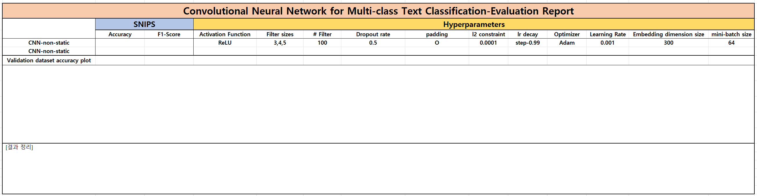
Assignment 4: CNN for sentence classification
[Evaluation report]

Slide 24
Assignment 4: CNN for sentence classification
Evaluation Criteria
Simplicity | How concisely did you write the code? 배점 4점 SNIPS data preprocessing: 1점 CNN-rand: 1점 CNN-static: 1점 CNN-multi-channel: 1점
Performance | How well did the results of the code perform? - 배점 1점 SNIPS acc 95.0% 이상 달성: 1점

Slide 25
Assignment 4: CNN for sentence classification
Due to : ~ 4/21 (Mon) 23:59:59
Submission : Online submission on cybercampus
Your submission should include
The whole code of your implementation
The evaluation report
You must implement the components yourself!
File name : StudentID_Name_HW4.zip

Slide 26
Q&A

